Slide 1
Module 10 Monitoring and Maintenance of Process Instrumentation
Dr. Belle R. Upadhyaya
Seyed A. Niknam
College of Engineering
Nuclear Engineering Department
The University of Tennessee
© 2014

Slide 2
Introduction
Continuous monitoring of instrument channels serves many purposes during plant operation.
These include: - Reliable control actions - Improved operator decision making - Proper actions of protection systems
Implications of this technology are: -Reducing challenges on control systems -Minimizing plant downtime -Planning maintenance/calibration tasks

Slide 3
Module Outline
Description of a typical instrument channel and classification of errors.
Signal Validation (or validation of instrument channel outputs) using digital signal processing techniques.
Sensor monitoring using random fluctuation data.
Instrument calibration verification and calibration reduction of redundant sensors.
Case studies from applications to process sensors.

Slide 4
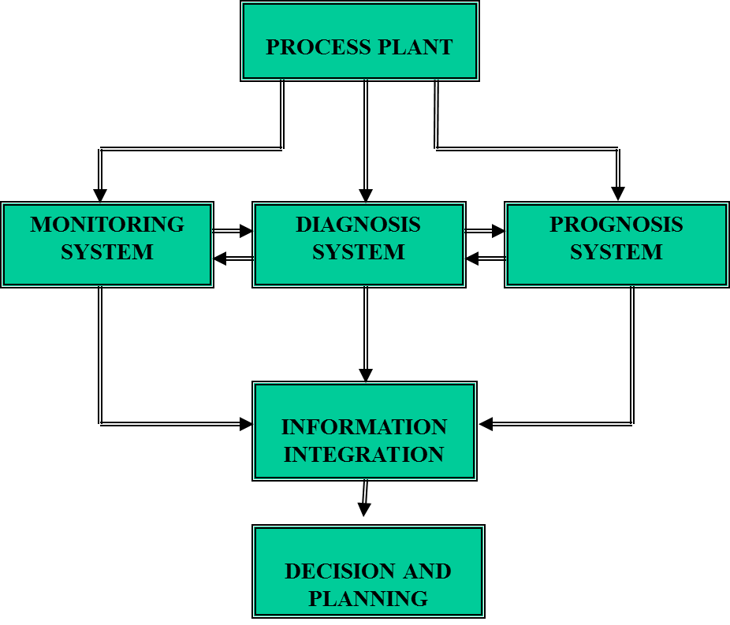
Integrated Monitoring, Diagnosis, and Prognosis System

Slide 5
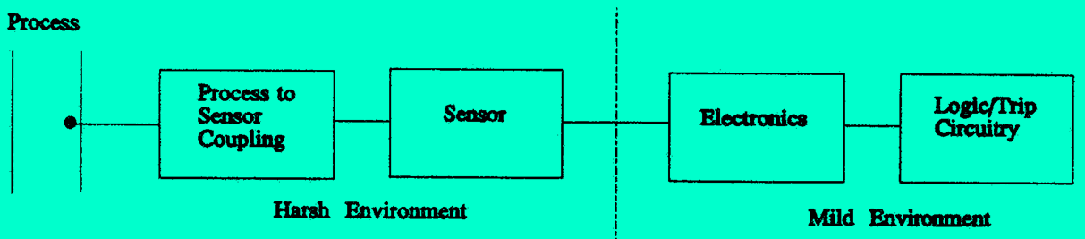
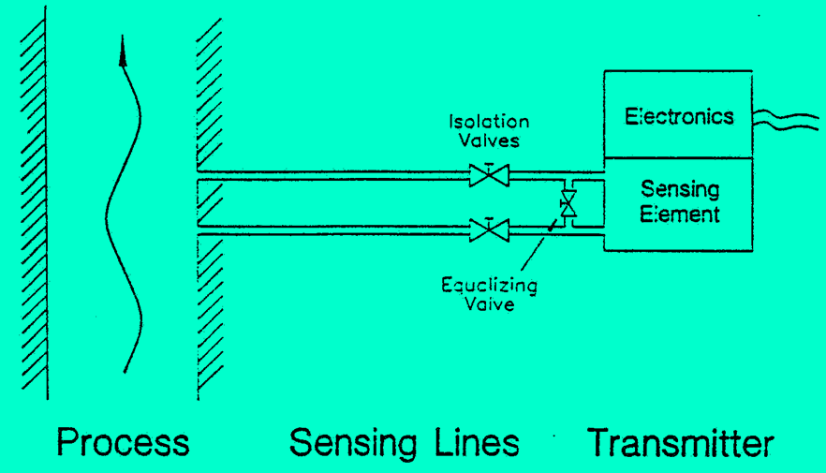
A Typical Instrument Channel
An instrument channel has several components as shown in the figure.
Instrument Channel for a Pressure Transmitter

Slide 6
A Typical Instrument Channel
Sensor: the element that responds to the process being measured.
Sensors for power and process plant applications must be designed to withstand harsh environment (nuclear radiation, high temperature, pressure, flow, high humidity, and dusty or unclean environmental conditions).
Electronics for conversion of one electrical quantity to another (resistance to voltage, capacitance to voltage, amplification, noise removal, etc.).
A measurement device consisting of a signal digitizer, processor for conversion to actual physical units.
Logic/trip circuitry as part of a safety system.

Slide 7
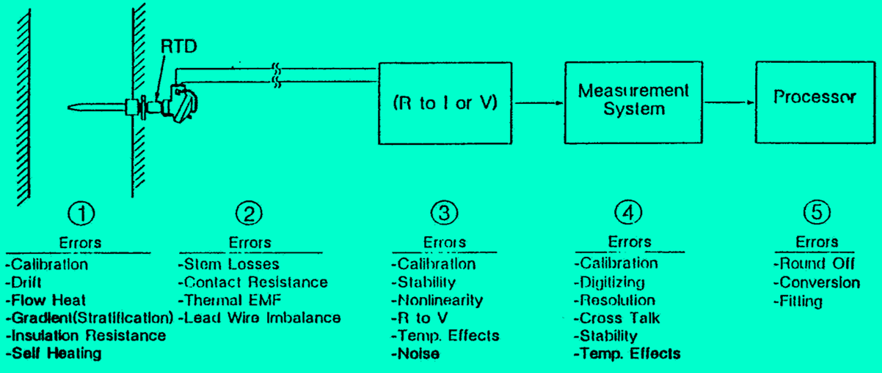
Examples of Sources of Errors in Instrument Channels
A typical measurement system using resistance temperature detector (RTD) is shown.
The sources of error may differ depending on the process variable being measured.

Slide 8
Common Problems in Instrument Channels
Calibration errors
Process effects (flow patterns)
Electronic equipment drift
Circuit imbalance (lead wires)
Measurement system errors
Computational errors
Sensing line blockage or air entrapment in pressure transmitters.

Slide 9
Anomalies in Observed Measurements
Anomalies in an observed measurement can be detected by proper monitoring techniques. The anomalies may have one or more of the following characteristics:
Excess noise or unusually low noise
Bias or slow drift in signals
Spurious high values occurring at random or regular time intervals.
Signal modulation
Signal clipping or saturation (due to exceeding the limits of devices)
Low or high signal levels
Signal deviations biased to one side of process value(due to sticking of moving parts)

Slide 10
Signal Validation Technology
Scope of signal validation in process plants
Generalized consistency checking of redundant channels
Process empirical modeling for independent signal estimation
Single signal anomaly detection
Artificial neural network models for signal estimation
Signal monitoring using random fluctuation data.

Slide 11
Scope of Signal Validation
A comprehensive approach for validating signals used in control systems, protection systems, and plant monitoring systems increases the reliability of implementation in operating plants.
Digital Signal Processing (DSP) and data-driven modeling are developed for information extraction using measurements from operating power plants.

Slide 12
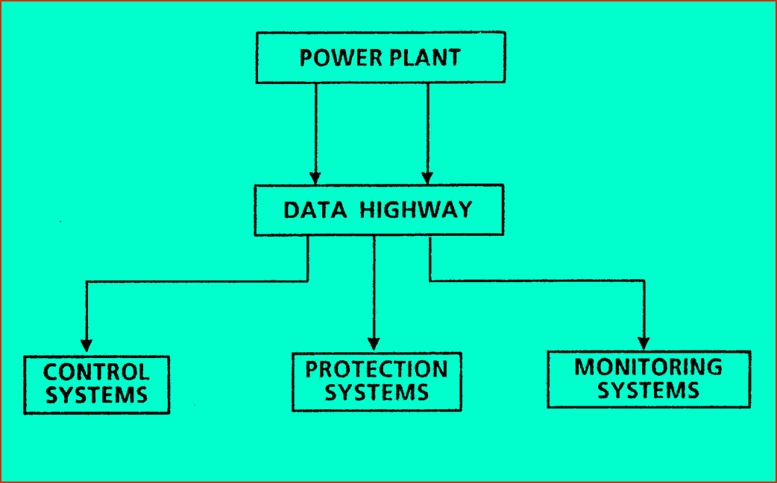
Instrument Channels Used in Plant Systems

Slide 13
Need for Sensor Fault Monitoring in Power and Process Industry
Improve product quality through product control
Improve reliability of operator decision
As an aid for scheduling maintenance, and to minimize plant downtime
Detect both slow and fast degradation of sensors

Slide 14
What is Signal Validation?
Determine the consistency of redundant measurements
Estimate the values of process variables (prediction)
Detect, isolate, and characterize anomalies in instrument outputs

Slide 15

Types of Instrument Failures
Noise, pulse, and bias errors
De-calibration error
Changes in response time of sensors
Saturation effects exhibited by sensors
Changes in actuator characteristics
Both slow and fast failures need to be monitored
Slow degradation is of primary concern in power and process plants.

Slide 16
Issues for Consideration in Failure Detection System Design
Rapid response and incipient failure detection
Must make use of system redundancy
Must aid in reducing design redundancy
Must be able to identify sensor anomaly and abnormal system behavior
Must aid in system reconfiguration without plant shutdown.

Slide 17
Issues for Consideration in Failure Detection System Design
Must be useful in post-accident diagnostics and for plant recovery following loss of certain instrumentation.
Fault detection system must be computationally efficient modular and parallel implementation

Slide 18
Three Tasks to be Performed by a Sensor Monitoring System
Failure detection
Isolation of failed instrument channel
Failure characterization
Increasing Degree of Complexity

Slide 19
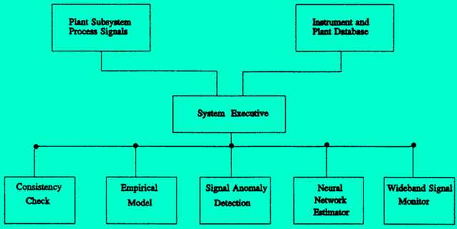
Signal Validation System (SVS)
Schematic of SVS architecture showing multiple modules

Slide 20
Methods for Signal Validation
Generalized Consistency Checking (GCC) for single and multiple variable using redundant measurements.
Process Empirical Modeling (PEM) for estimating critical signals.
Bias and Noise Detection (BND).
Artificial Neural Networks (ANN) for signal estimation.
Univariate Auto-regression (UAR) modeling for wide-band signal analysis (also Multivariate AR modeling).

Slide 21
Generalized Consistency Checking
Provides a systematic procedure to validate measurements using redundant instrument channels.
An estimate of the signal (sensor output) is obtained.
In general, a network of single consistency checking modules is used to validate multiple signals.

Slide 22
Generalized Consistency Checking (cont.)
A cross comparison of redundant measurements is performed.
In addition to the direct measurements, analytical or empirical redundancy may be utilized.
Application to consistency checking of multiple variables.
Common-mode failure detection.

Slide 23
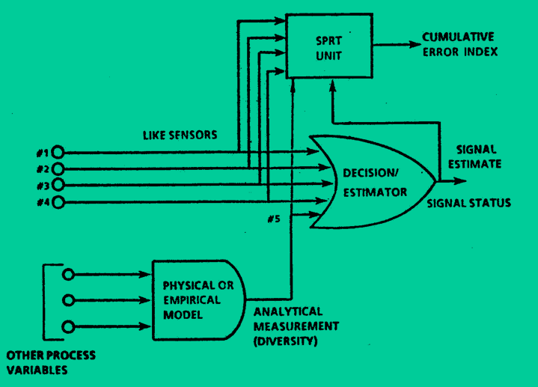
Generalized Consistency Checking
The Generalized Consistency Checking module for single variable showing the decision/estimator and the Sequential Probability Ratio Test (SPRT) units.

Slide 24
Consistency Checking of Redundant Sensors
Consider n sensors measuring the same process variable, X(t). Let {m₁, m₂, … , m_{n}} be the n measurements of X(t) at time t.
Define the allowable tolerance between any two measurements of {m₁, m₂, … , m_{n}} as b_{ik}, which incorporates tolerances of both measurements.
Any two measurements {m_{j}, m_{k}} are said to be consistent with each other if
abs (m_{j} - m_{k}) < b_{ik}

Slide 25
Consistency Checking of Redundant Sensors (cont.)
If the two measurements are such that
abs (m_{j} - m_{k}) > b_{ik}
then m_{j} and m_{k} are inconsistent with each other.
Example: Choose measurement m₁ and compare it with all the other redundant measurements for its consistency. If m₁ is inconsistent with another measurement, then the inconsistency index of m₁ increases by one.

Slide 26
Consistency Checking of Redundant Sensors (cont.)
Example (cont.): Perform this cross-check with all the redundant measurements. For example, if the measurement m₁ is inconsistent with all the other redundant measurements, then the inconsistency index for sensor m₁ = n-1.
An estimate of X(t) may be obtained by excluding this measurement and using a simple average of the remaining n-1 measurements
Average X(t) = (m₂ + … + m_{n})/(n-1)

Slide 27
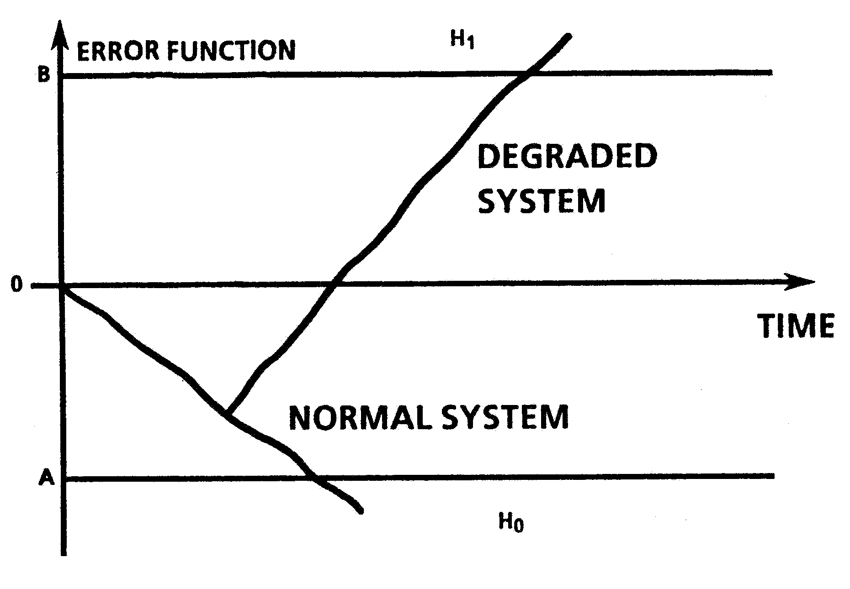
Cumulative Error Analysis

Slide 28
Examples Using Simulated Measurements
False and Missed Alarm Probability = 0.01
Average Time Between False Alarms = 10,000 Samples
Normal Background Noise - Variance = 1 F²
Variance for Degraded Condition = 4 F²
Tolerance for consistency check = 3 F (for all measurements)
Tolerance for bias SPRT = 4 F
Signal #1 is normal
The choice of above parameters requires experimentation.

Slide 29
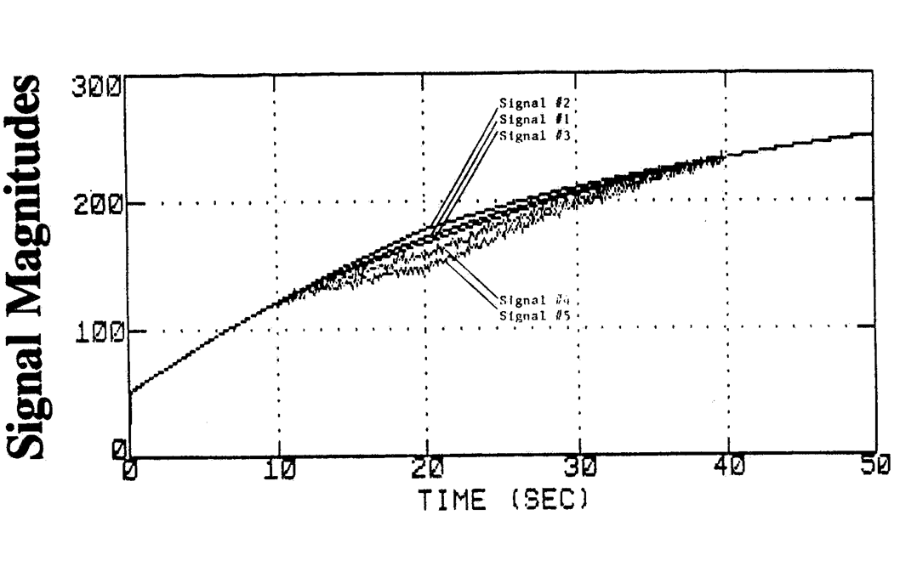
Redundant Measurements
Five redundant temperature signals (°F) with bias, noise, or both errors in the various signals.

Slide 30
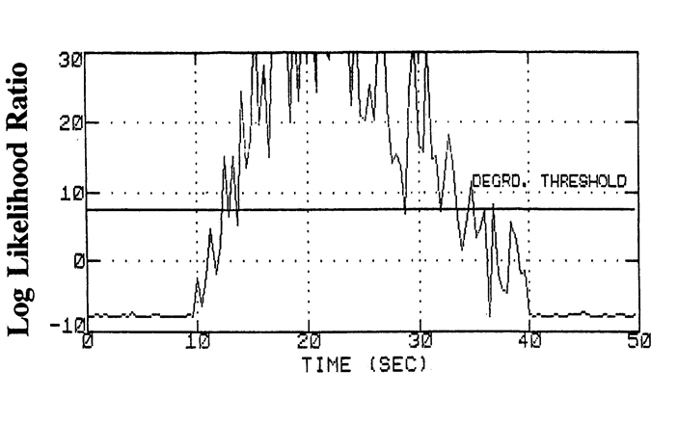
Sequential Probability Ratio Test for Bias Degradation
Signal #4 Specified mean time between false alarms = 1000.0s Specified maximum acceptable bias degradation = 4
Log likelihood ratio of SPRT for bias error in signal #4

Slide 31
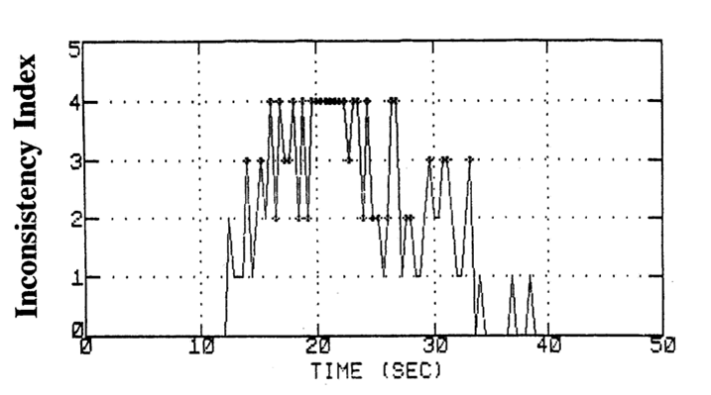
Time History of Inconsistency Error Index
Signal #4
Signal tolerance = 3.0, No. of redundant signals = 5
Inconsistency index for signal #4. The samples at which the original signal is excluded from the set are indicated by cross marks.

Slide 32
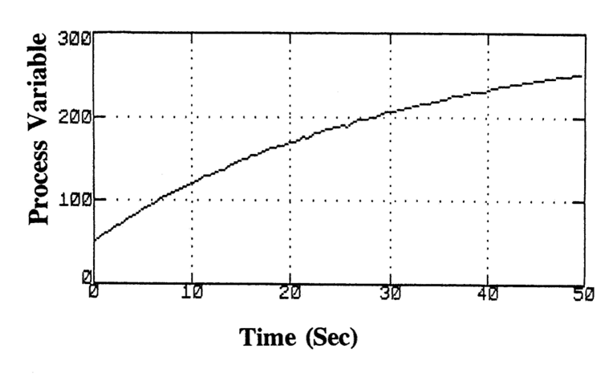
Estimated Temperature Using Redundant Measurements
Signal tolerance = 3.0, No. of redundant signals = 5
The estimate of the process variable based on five redundant signals.

Slide 33
Schematic of a PWR Plant

Slide 34
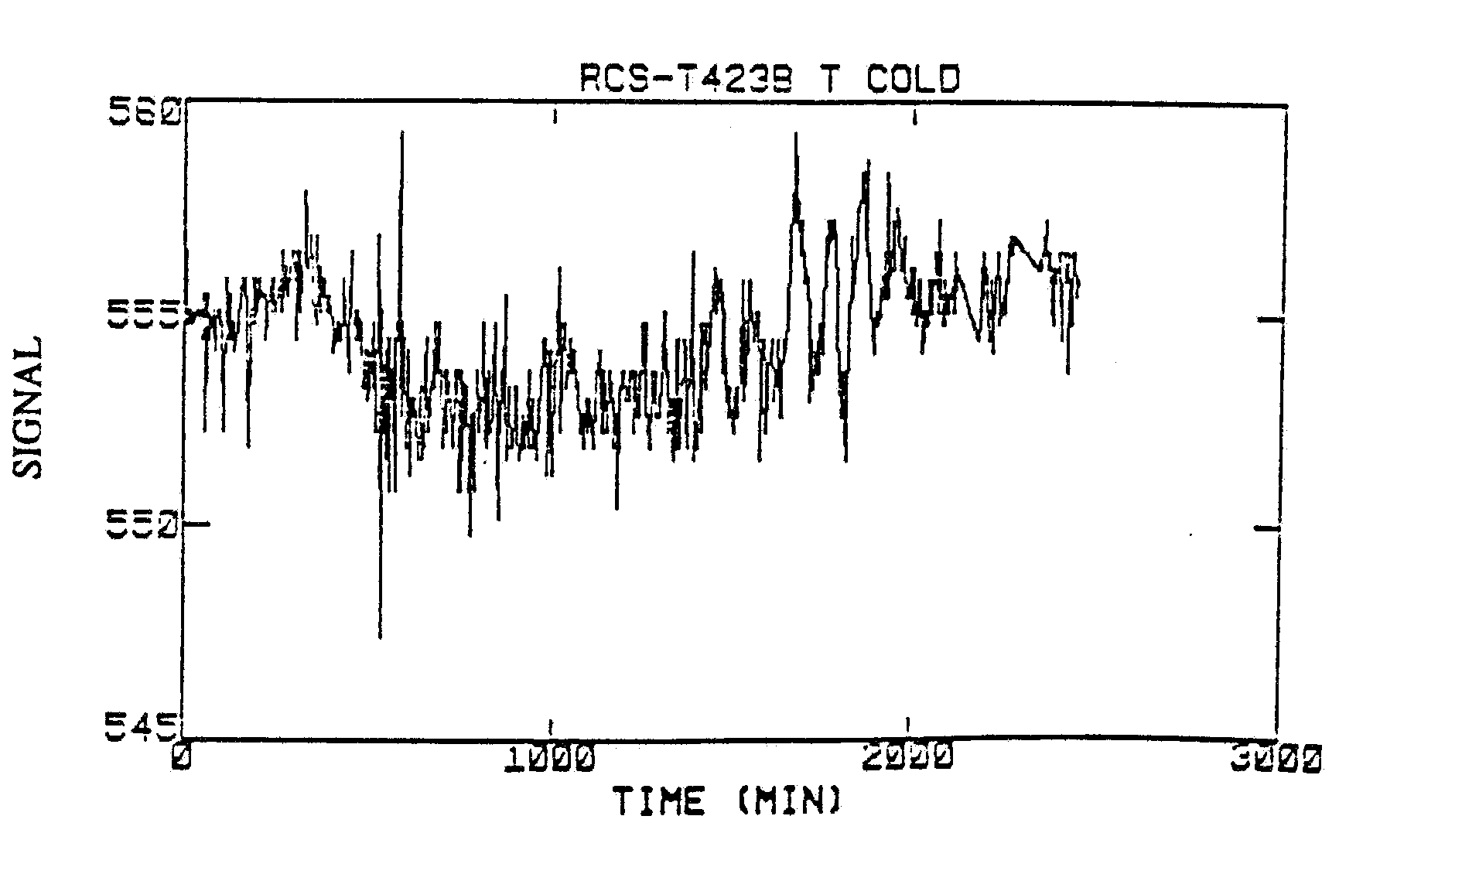
PWR Operational Startup Data: Cold Leg Temperature, Measurement #1

Slide 35
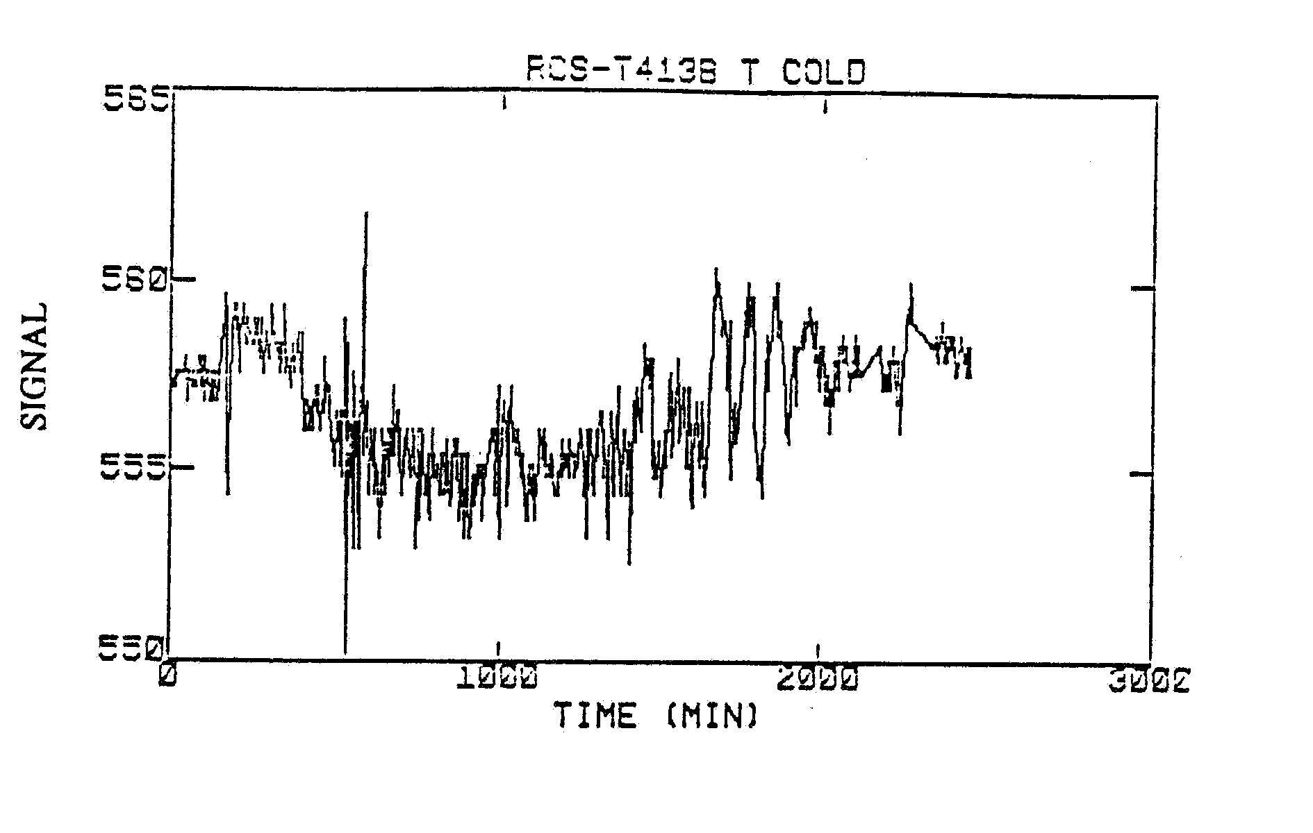
PWR Operational Startup Data: Cold Leg Temperature, Measurement #2

Slide 36
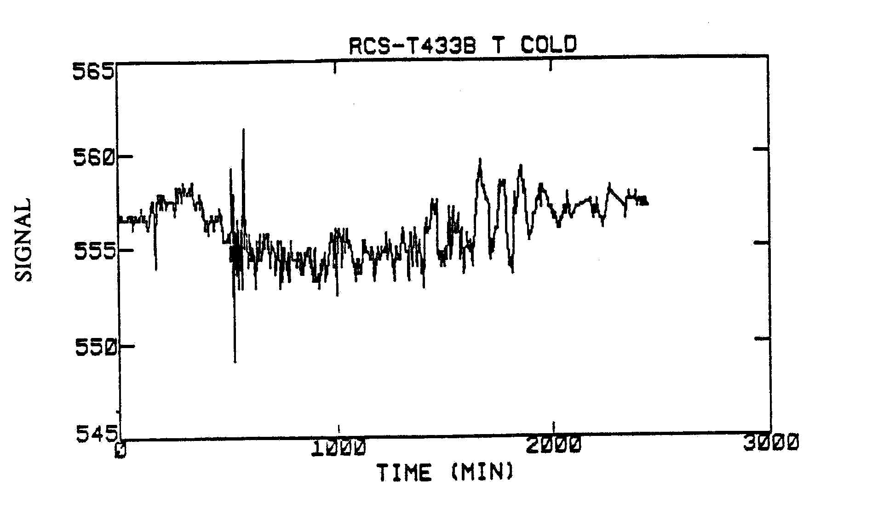
PWR Operational Startup Data: Cold Leg Temperature, Measurement #3

Slide 37
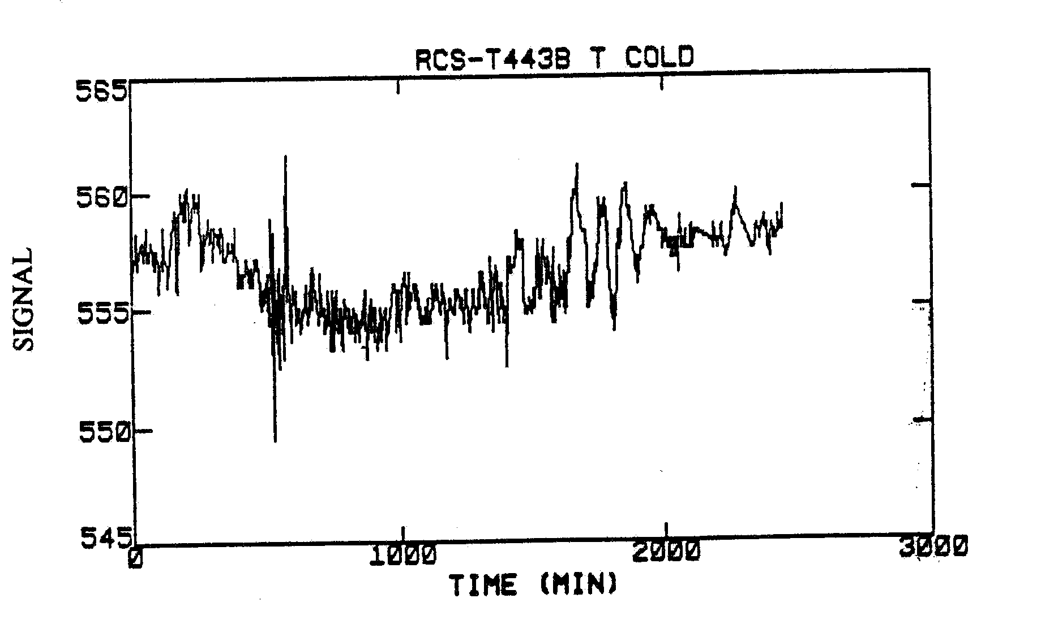
PWR Operational Startup Data: Cold Leg Temperature, Measurement #4

Slide 38
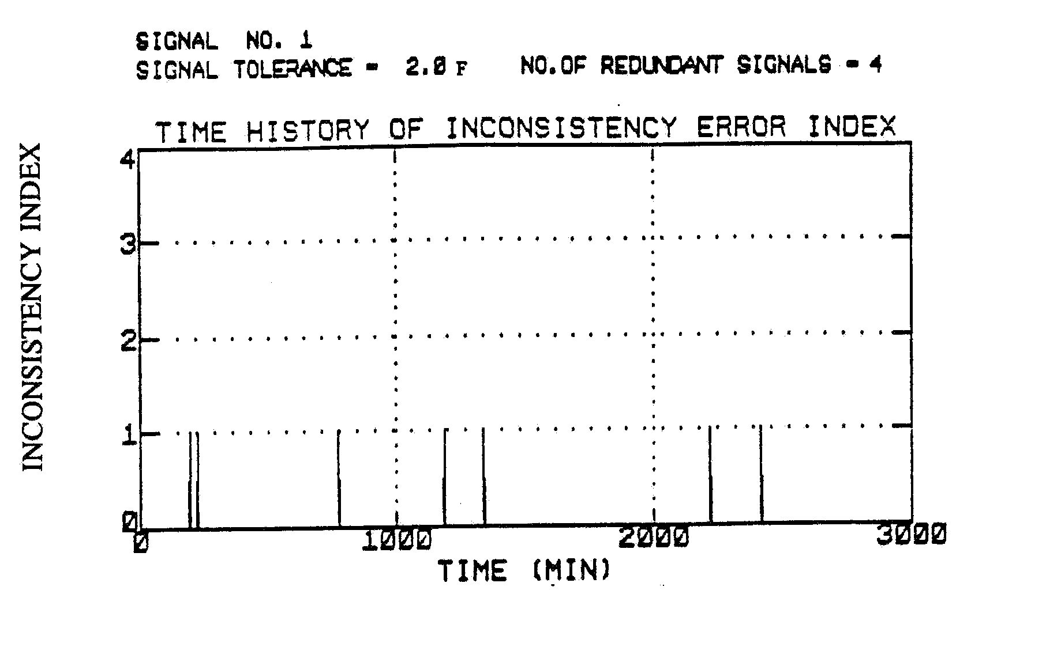
PWR Operational Startup Data: Cold Leg Temperature, Measurement #1

Slide 39
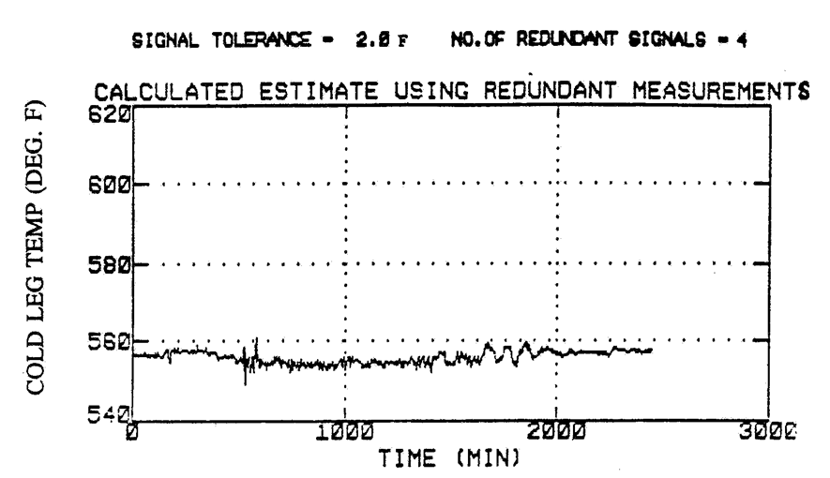
Estimated Value of the Cold Leg Temperature Signal
Estimated value using all the four redundant measurements. The estimation is a weighted average of the four measurements according to their inconsistency indices.

Slide 40
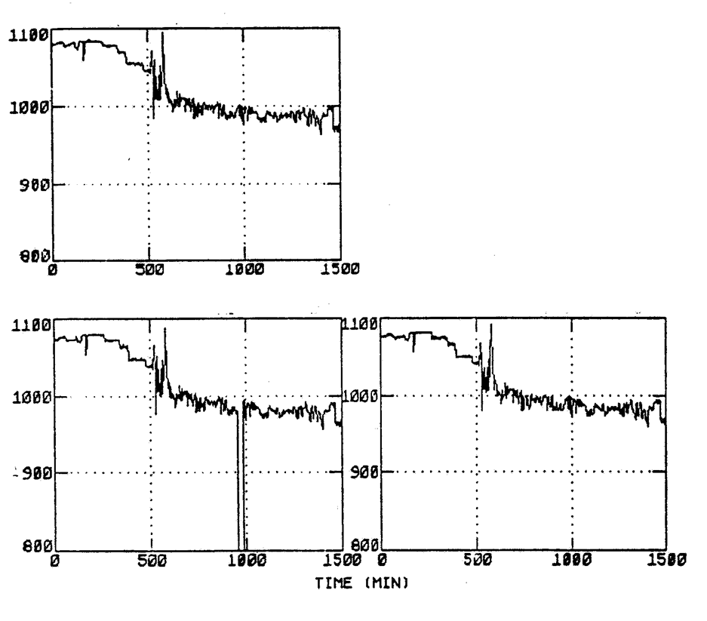
Steam Generator Pressure Signals (3)

Slide 41
Process Empirical Modeling (PEM)
Non-linear empirical models are established to estimate a process variable as a function of other related variables.
The observed instrument output is compared against the model-predicted output to detect a bias or a drift in the signal.

Slide 42
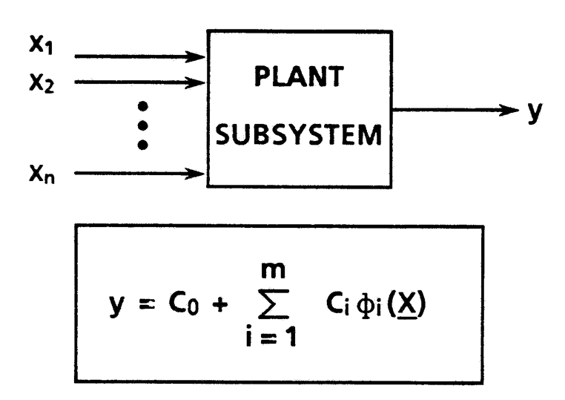
Process Empirical Modeling (PEM)
Automated generation of data-driven models for system characterization

Slide 43
Features of PEM Module
Applicable to both batch processes and continuous processes.
Database clustering may be needed to improve modeling accuracy.
Prediction of critical variables to monitor incipient signal anomaly.
Analytical measurement input to the generalized consistency checking module.

Slide 44
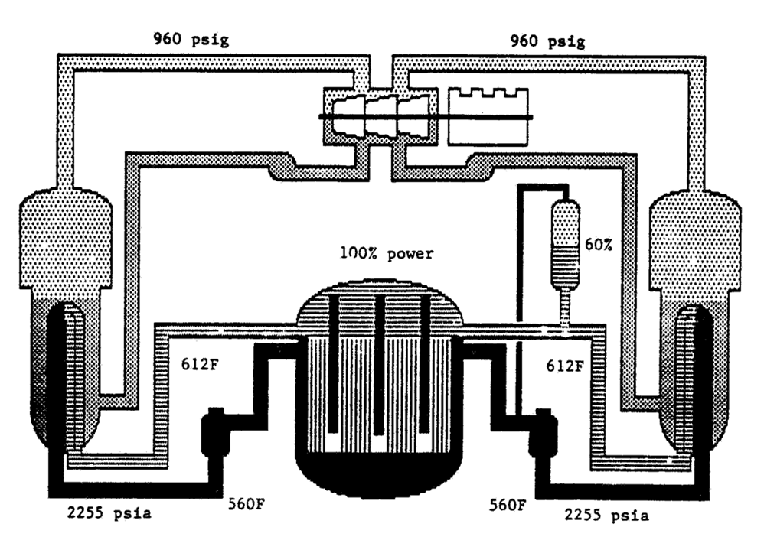
Schematic of a PWR Plant Showing Typical Values of Some of the Process Variables

Slide 45
Westinghouse Four-loop Pressurized Water Reactor (PWR)
The next seven slides show data taken from a Westinghouse four-loop PWR during plant startup. The power rating of this system is 1,100 MWe full power.
The data interval is 5 minutes.

Slide 46
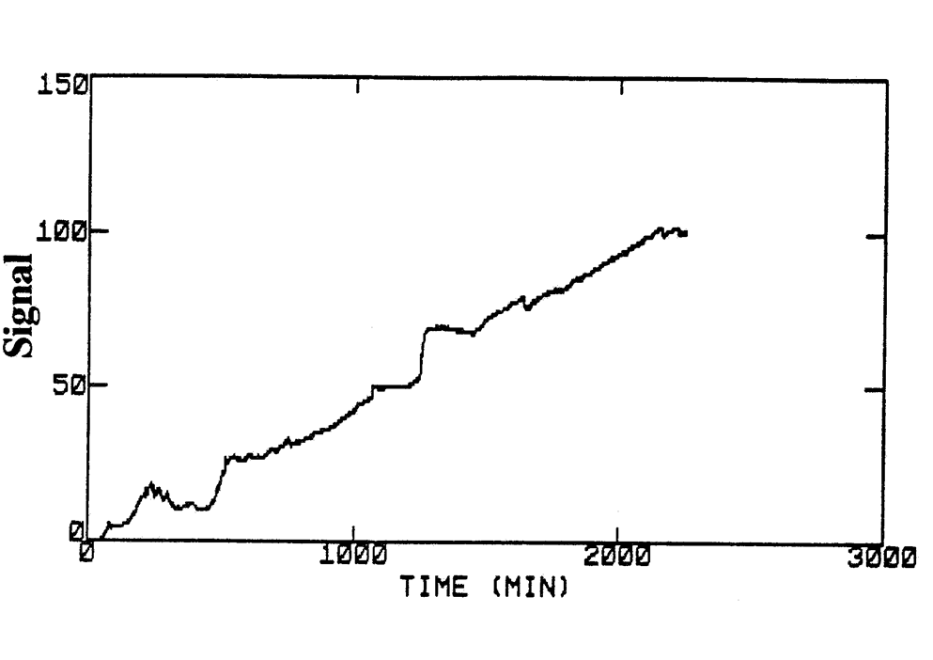
Reactor Power Signal (%)

Slide 47
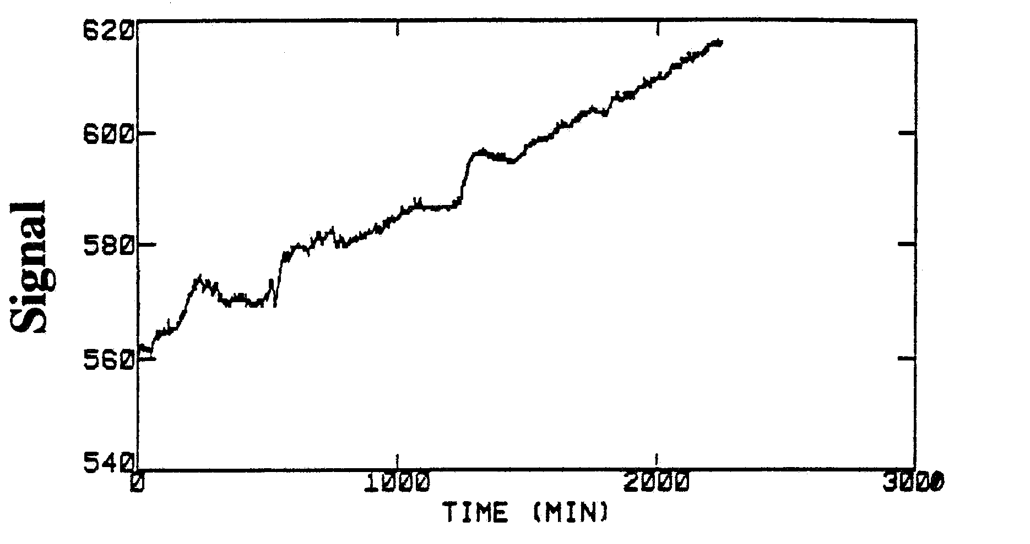
Hot Leg Temperature Signal (°F)

Slide 48
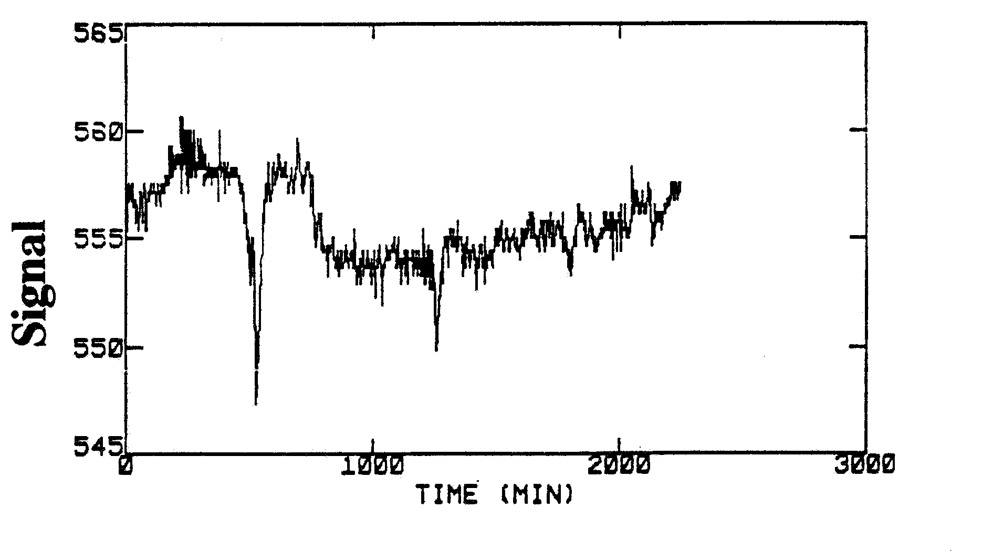
Cold Leg Temperature Signal (°F)

Slide 49
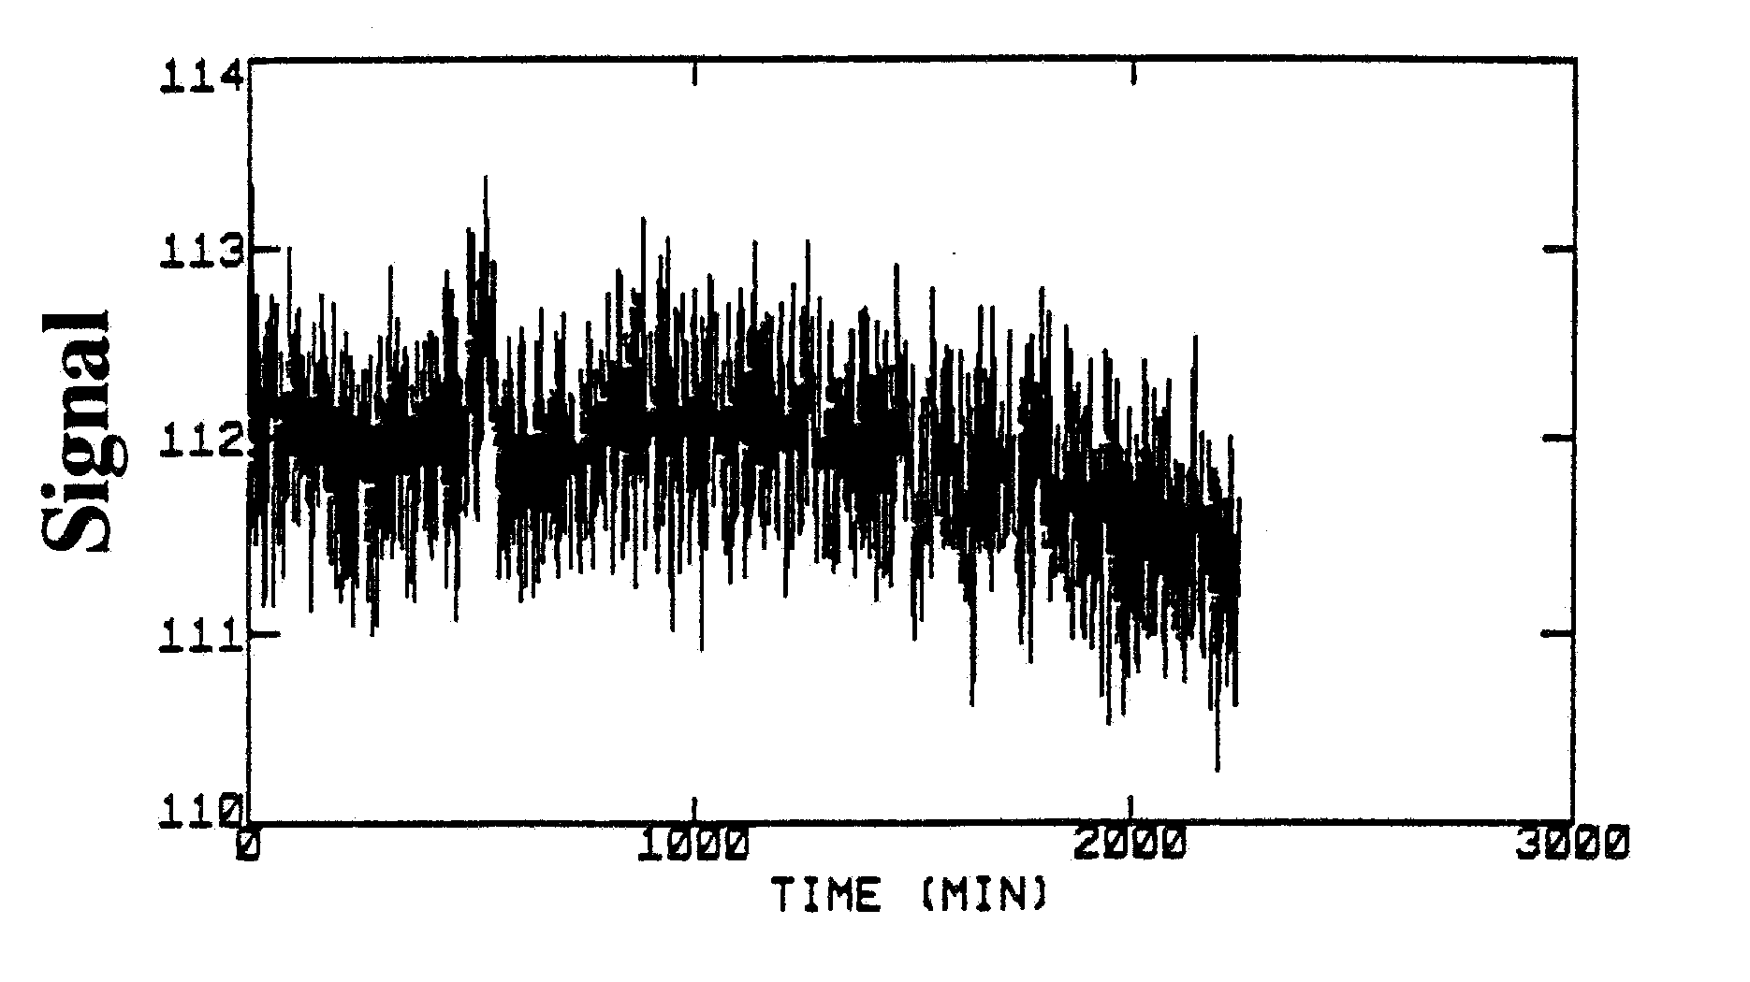
Reactor Coolant System Flow Rate Signal (gpm x 10³)

Slide 50
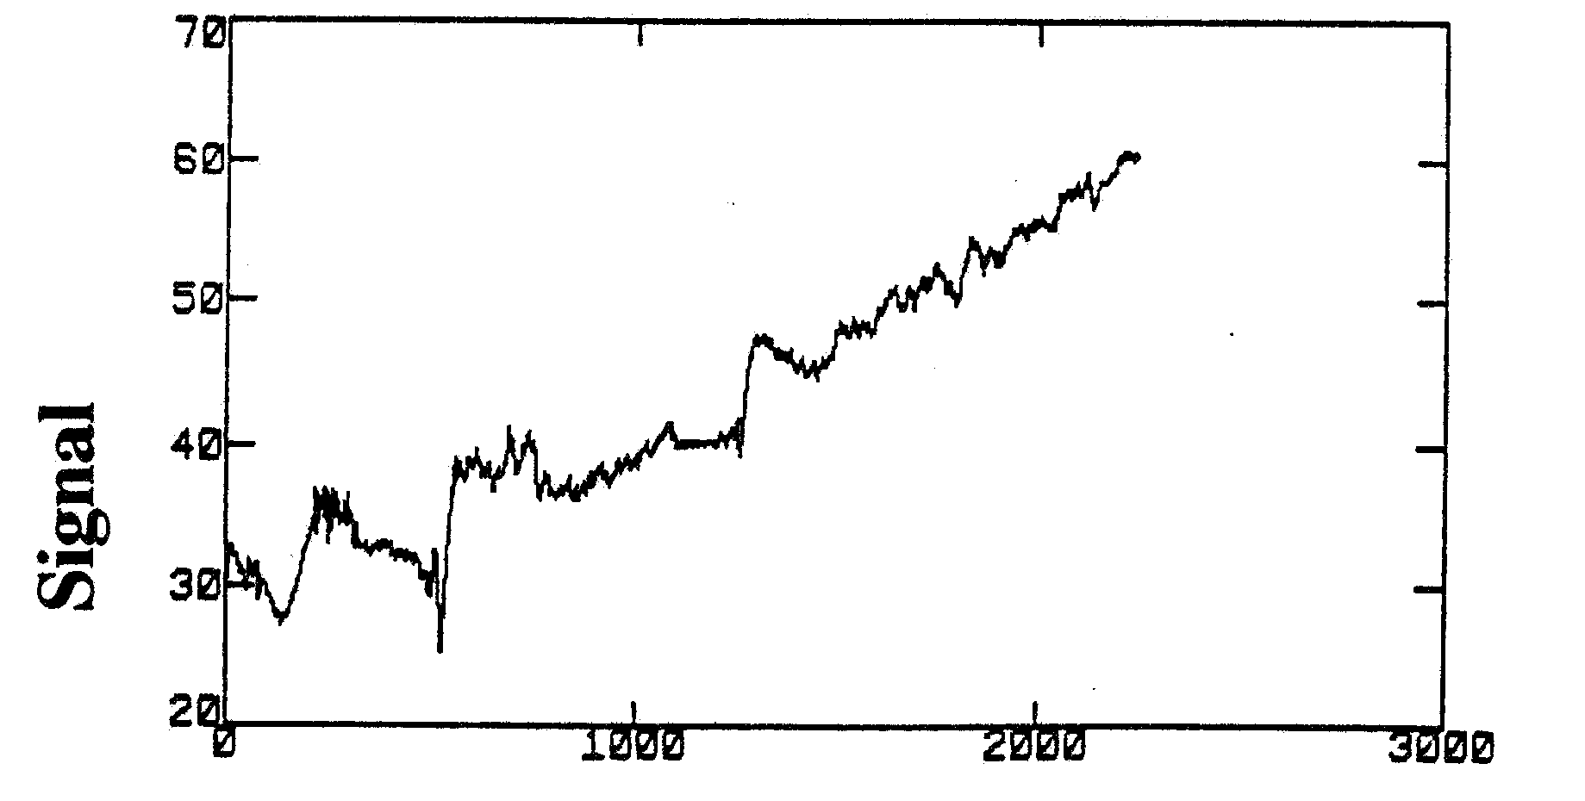
Pressurizer Level Signal (%)

Slide 51
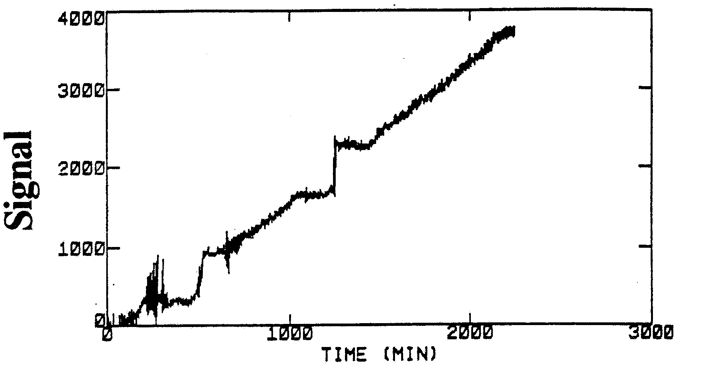
Steam Generator Flow Rate Signal (lbm/hr x 10³)

Slide 52
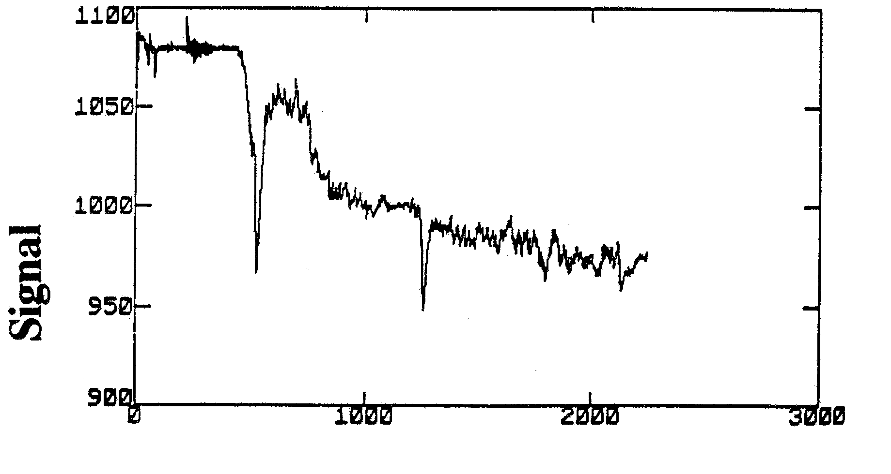
Steam Pressure Signal (lbf/in²⁾

Slide 53
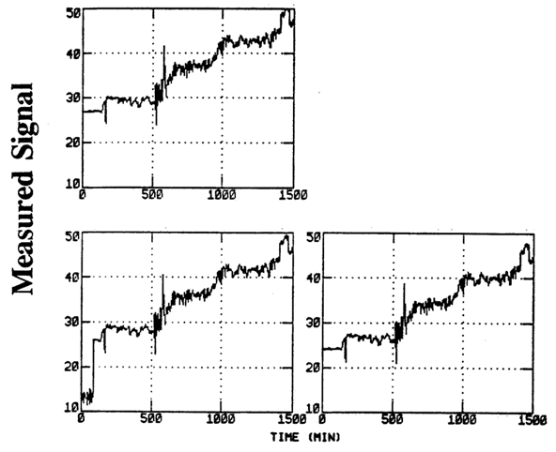
Measured Data from Three Redundant PWR Pressurizer Level Sensors

Slide 54
Estimation of Pressurizer Level in an Operating PWR
Comparison of measured (solid line) and model -predicted (+) values of an operating PWR pressurizer level (%) signal.
The input signals used for model fitting are reactor power, pressurizer pressure, hot leg temperature, and cold leg temperature.

Slide 55
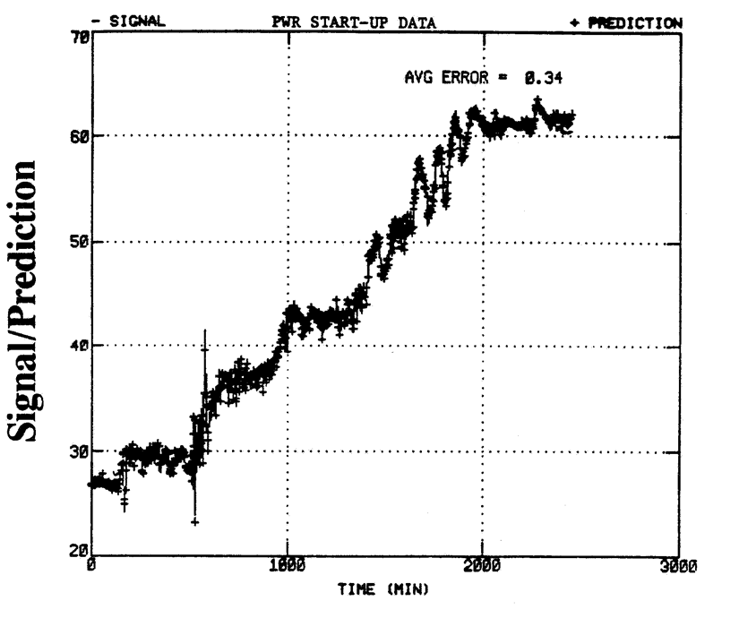
Estimation of Pressurizer Level in an Operating PWR

Slide 56
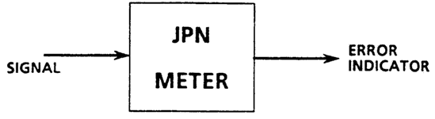
Bias and Noise Detection
Changes in basic signal characteristics are monitored.
These include signal level, noise RMS value, probability distribution, and zero-crossing rate.
Jump, Pulse, Noise (JPN) Detection
This module checks for jumps, pulses, and noise changes in signals to identify faulty sensors.

Slide 57
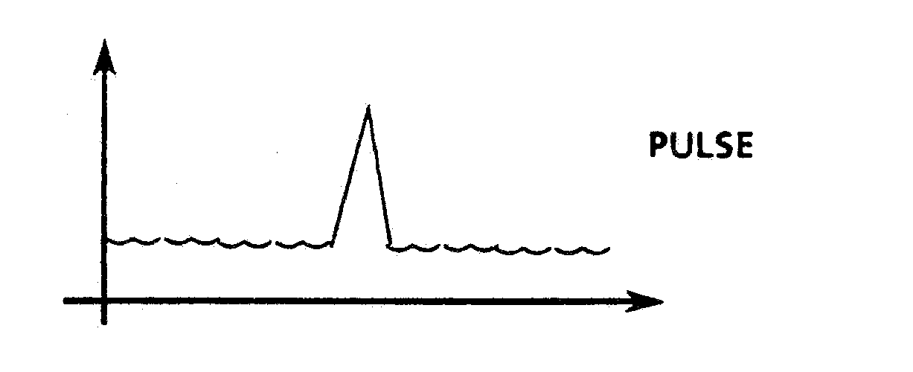
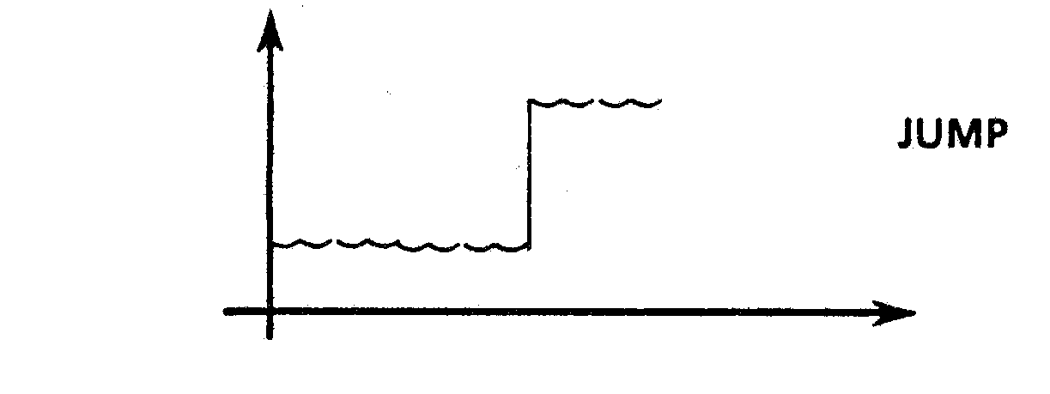
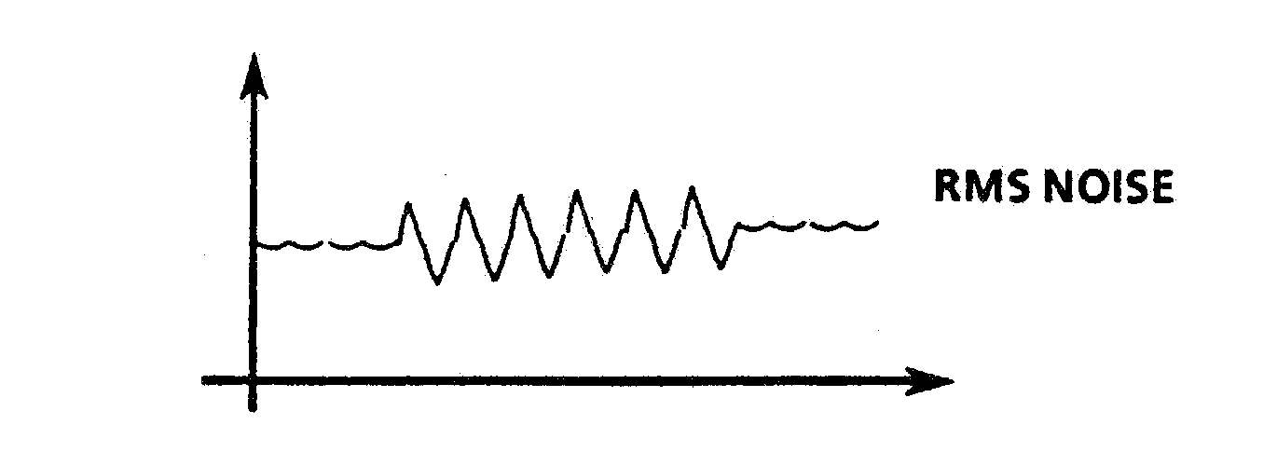
Jump, Pulse, Noise (JPN) Detection

Slide 58
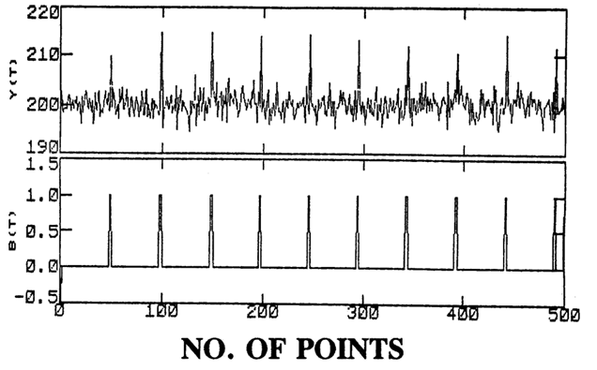
Signal with Simulated Pulse Type Anomaly
Pulse-type anomaly and the binary error index.

Slide 59
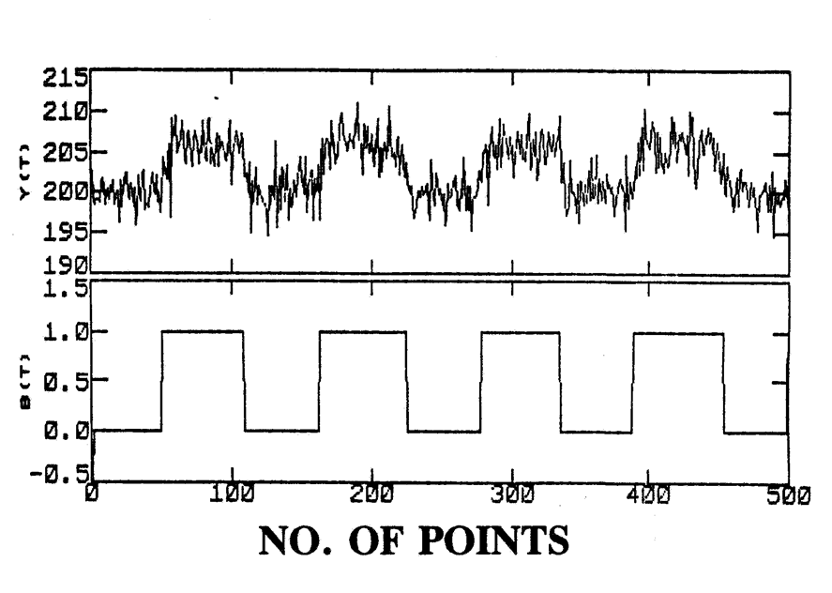
Signal with Simulated Bias (Jump) Anomaly
Bias (jump) type and the binary error index

Slide 60
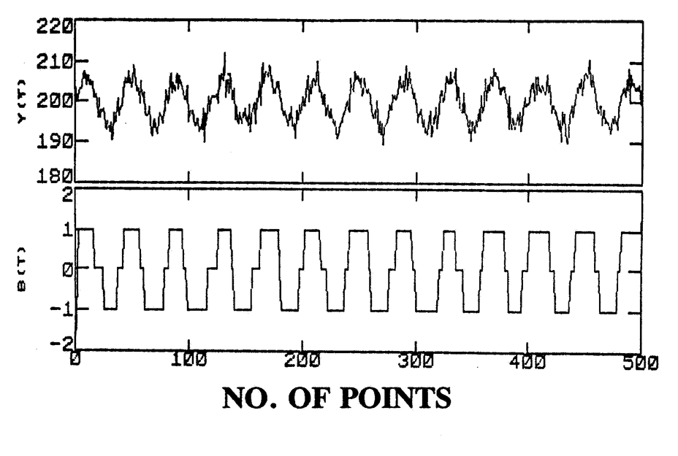
Signal with Simulated Sinusoidal Type Anomaly
Sinusoidal type anomaly and the binary error index

Slide 61
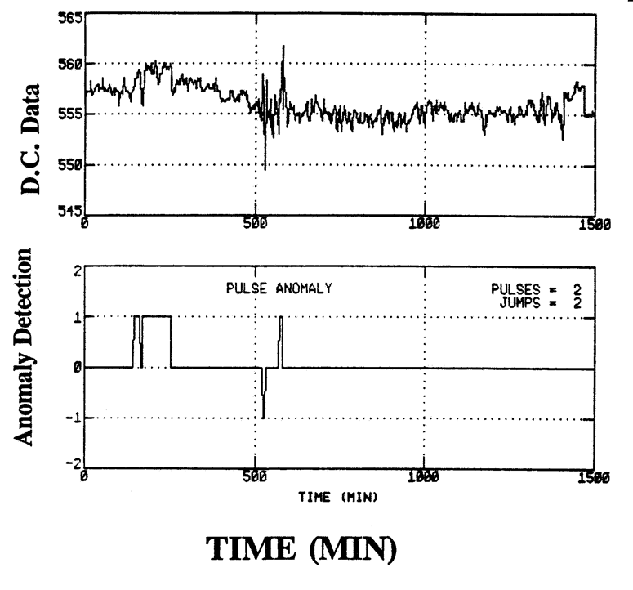
Detection of Signal Level Changes

